Slide 1
COVID-19 diagnosis from CT Scans using Deep Learning
Project Guide, Submitted by,
Dr.Nadera Beevi S Sruthimol Biju
TKM19MCA023
Department of Computer Application
Thangal Kunju Musaliar College of Engineering,Kollam
June 03, 2022

Slide 2
Contents
1. Introduction
2. Related Work
3. Gap identified
4. Problem Statement
5. Objectives
6. Methodology
7. Result and Discussion
8. Conclusion and Future Enhancement
9. References
10.Screenshots

Slide 3
Introduction
COVID-19 is a highly infectious disease.
This disease is caused by SARS-CoV-2.
Different kinds of methods have been used to confirm the suspected COVID-19. Eg: RT-PCR, nonPCR tests .
COVID-19 diagnosis from CT-images can be created to help support radiologists.

Slide 4
Related Work
SI.No | Title of the Paper, Journal name, Publisher, Year | Pros of that Paper | Cons of that paper
1 | COVID-19 diagnosis and severity detection from CT-images using transfer learning and back propagation neural network ,,AswathyA.L,AnandHareendran.S,Vinod ChandraS.S, Journal of Infection and Public Health ,Elsevier(2021) | This work advances state-of-the-art methods in COVID-19 detection and severity prediction. It’s overcome gradient vanishing problem. | severity detection from 3D CT volumes.
2 | Sample-efficient deep learning for COVID-19 diagnosis based on CT scans, MedRxiv, He X, Yang X, Zhang S, Zhao J, Zhang Y, Xing E, et al., IEEE,2021 | Achieved high diagnosis accuracy. This work done on publicly available dataset. | Limited dataset
3 | Covid-net: a tailored deep convolutional neural network design for detection of COVID-19 cases from chest radiography images;Wang L, Wong A.,Scientific Reports, nature research, 2021. | They proposed a multi-classification as normal, viral infection, bacterial infection, and COVID-19 infection. | It’s not a highly accurate yet practical deep learning solutions.

Slide 5
SI.No | Title of the Paper, Journal name, Publisher, Year | Pros of the Paper | Cons of that paper
4 | A deep transfer learning model with classical data augmentation and CGAN to detect COVID-19 from chest CT radiography digital images; Loey M, Smarandache F, Khalifa NEM.,Springer,nature,2020. | Avoid the scarcity of the limited benchmark datasets for COVID-19, especially in chest CT images. | The major drawback is not trying most of deep learning models to get highest performance measurement.
5 | Covidx-net: a framework of deep learning classifiers to diagnose COVID-19 in X-ray images Hemdan EE-D, Shouman MA, Karar ME. IEEE, 2020. | This study demonstrated the useful application of deep learning models to classify COVID-19 in X-ray images based on the proposed COVIDX-Net framework. | This study validated on less data set.

Slide 6
Gap identified
Most of the existing works in this area have not used standard datasets.
Those works are not providing more accuracy.
Chance of losing image information.

Slide 7
Problem Statement
To identify the diagnostic accuracy of common imaging modalities, CT for diagnosis of COVID-19 in the general emergency population in symptomatic patients.
This system assist radiologists to automatically diagnose COVID-19 in CT images.

Slide 8
Objectives
Infectious COVID-19 disease shocked the world and is still threating the lives of billions of people.
In this study, a new framework has been proposed to automatically identify or confirm COVID-19 in 2-D CT images based on two deep learning classifiers; namely InceptionV3,Xception.

Slide 9
Methodology

Slide 10
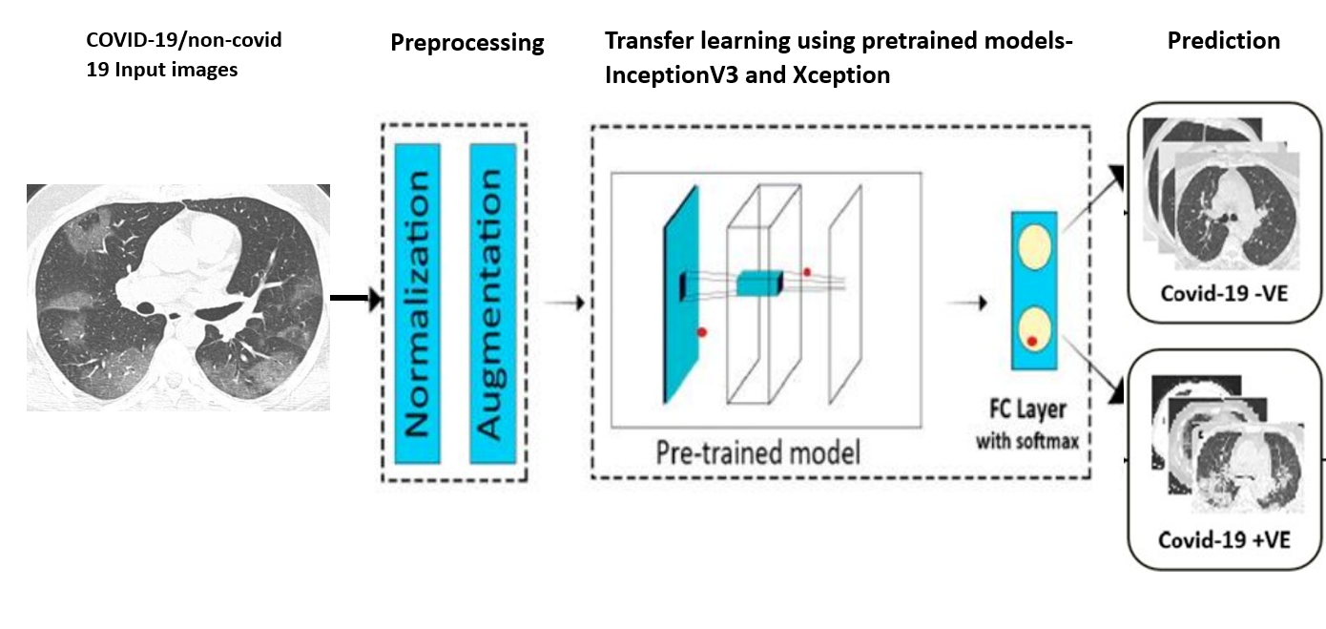
COVID-19 Diagnosis Block Diagram

Slide 11
Algorithm
Step1: Load images.
Step2: Define size to images to be resized.
Step3: Fetch images and class labels from files.
Step4: Normalization for modelling.
Step5: Split into training and testing sets.
Step6: Image Augmentation.
Step7: Building and training the model.
Step8: Prediction of the image Class.
Step9:Save model for future use.

Slide 12
The Dataset
The dataset for the project was gathered from Kaggle .
CT Scan images (750 images) were obtained within 2 classes.
80% of the images were used for training the models and the remaining 20% for testing the accuracy of the models.
Building the Model
First added 3 custom layers to the pretrained models so that they can be trained on our dataset.

Slide 13
Image Augmentation
First defined an Image Data Generator to train the models at modified versions of the images, such as at different angles, flips, rotations or shifts.
Training the Model
Training of the model was performed.
Trained the model for 500 epochs with a batch size of 32 images

Slide 14
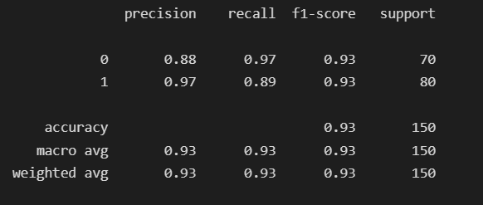
Result and Discussion
Classification Report of InceptionV3

Slide 15
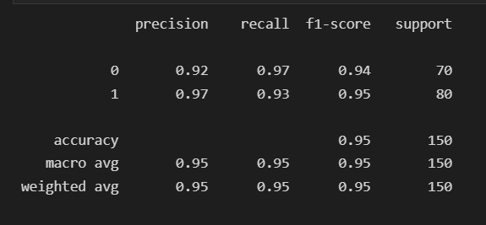
Classification Report of Xception

Slide 16
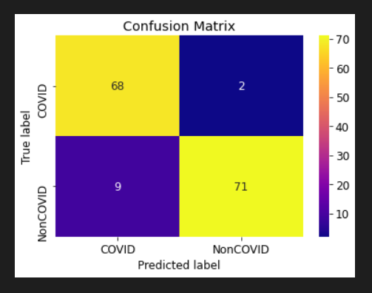
Confusion Matrix of InceptionV3

Slide 17
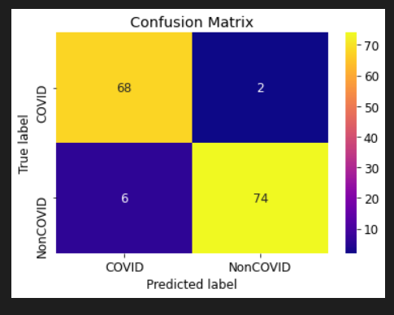
Confusion Matrix of Xception

Slide 18
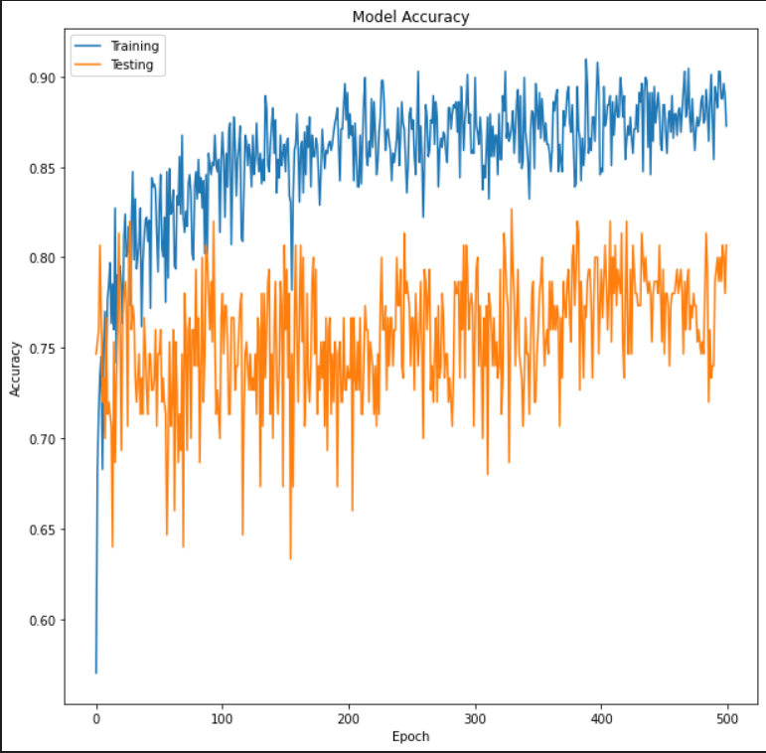
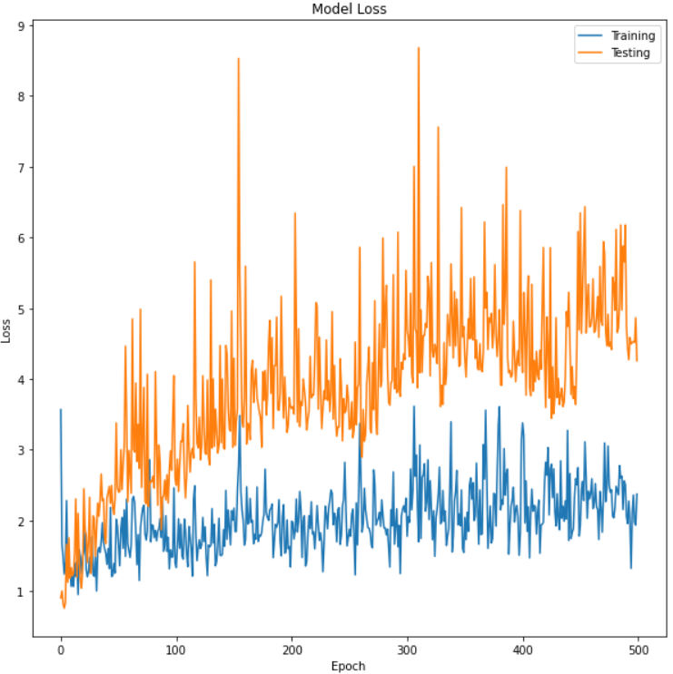
Model Accuracy and loss of InceptionV3

Slide 19
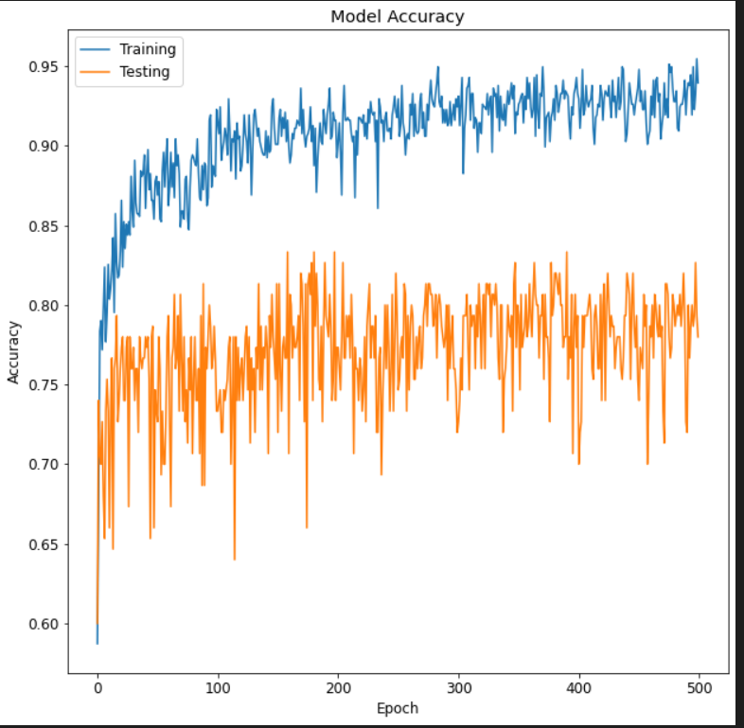
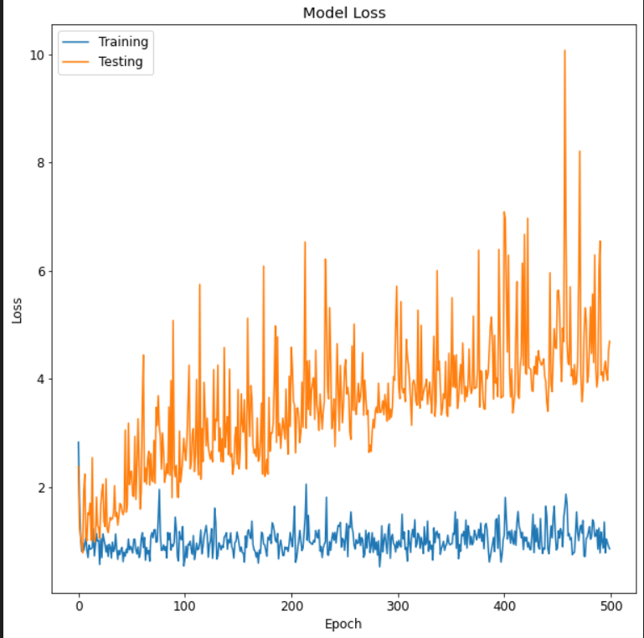
Model Accuracy and loss of Xception

Slide 20
Conclusion and Future Enhancement
It’s a computer-aided system for rapid diagnosis of COVID-19 and uses two deep learning classifiers; namely InceptionV3,Xception.
The results of this proposed model verified that the best performance scores of deep learning classifiers are the Xception model rather than the InceptionV3.
The work can be extended the severity detection of covid-19 in symptomatic patients is an important factor for arranging the necessary lifesaving facilities like ICU care and ventilator support.

Slide 21
References
COVID-19 diagnosis and severity detection from CT-images using transfer learning and back propagation neural network ,ELSEVIER,AswathyA.L,AnandHareendran.S,Vinod ChandraS.S.(2021)
Ahuja S, Panigrahi BK, Dey N, Gandhi T, Rajinikanth V. Deep transfer learningbased automated detection of COVID-19 from lung CT scan slices. Appl Intell 2020.
Barstugan M, Ozkaya U, Ozturk S. Coronavirus (COVID-19) classification using CT images by machine learning methods; 2020
Wang X, Deng X, Fu Q, et al. A weakly-supervised framework for COVID-19 classification and lesion localization from chest CT. IEEE Trans Med Imaging 2020

Slide 22
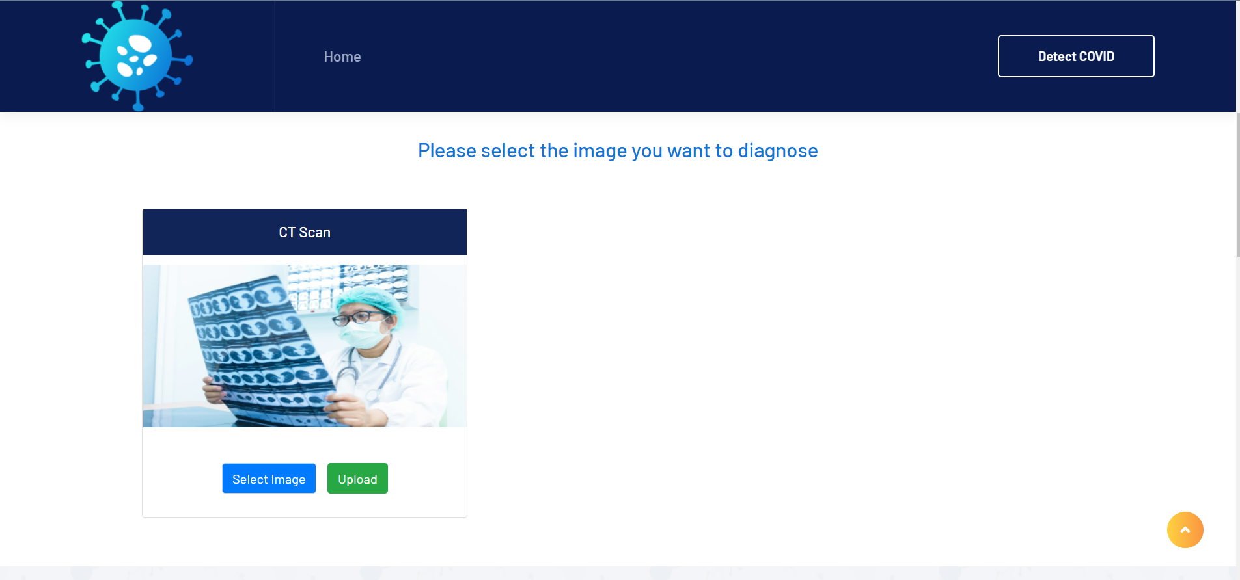
Screenshot

Slide 23
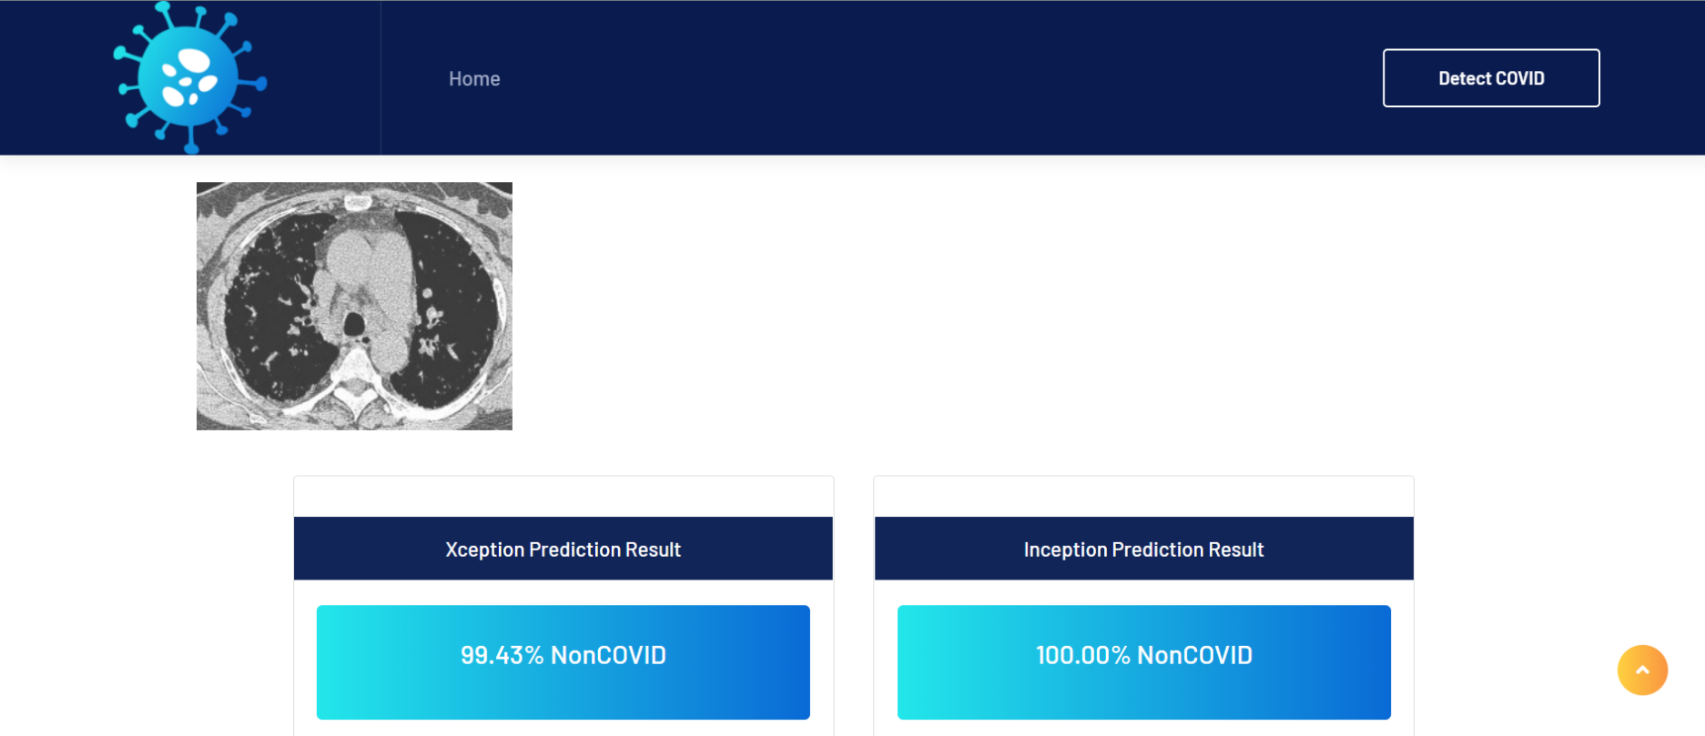

Slide 24
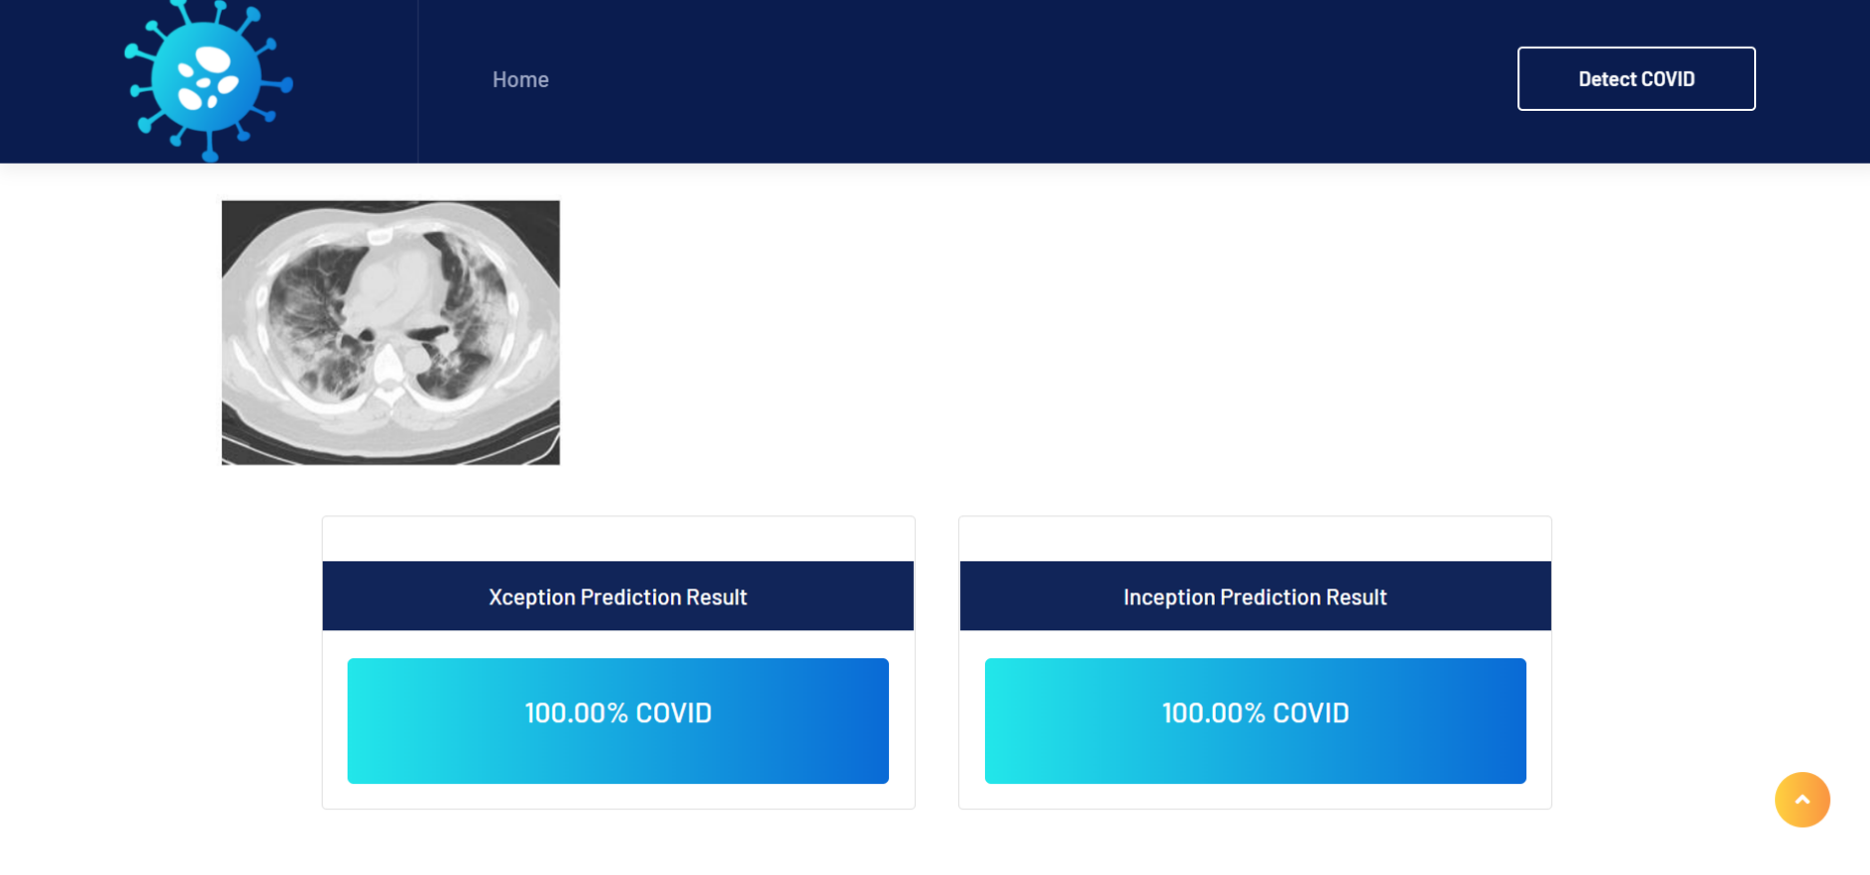

Slide 25
THANK YOU

